Slide 1
OVERCOMING OPTICAL SCATTERING IN PHOTOACOUSTIC IMAGING
WITH INTENSITY-RECOVERING
DEEP LEARNING MODEL
Department of Electrical and Computer Engineering
Christine Wu
Advisor: Chen Yun-Sheng
Spring 2021

Slide 2
OUTLINE
Problem Formulation
Where does optical scattering occur?
How do we plan to overcome it?
Model Scheme and Architecture
Convolutional Neural Network, NetP
Conditional Generative Adversarial Network, PowerNet
Trainings on Three Datasets
Simulation Dataset (Lab Generated Controlled Data)
Array Phantom (Real, but Structurally Controlled Data)
Hand Blood Vessel (Real Complex Data)
ECE / CHRISTINE WU
GRAINGER ENGINEERING

Slide 3
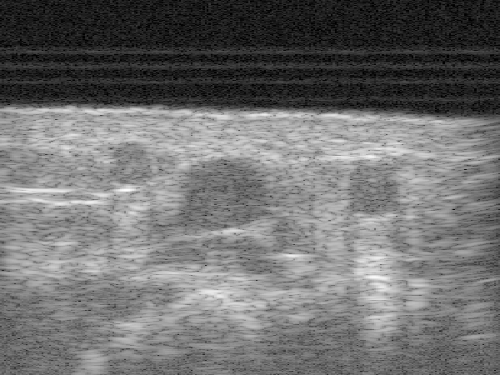
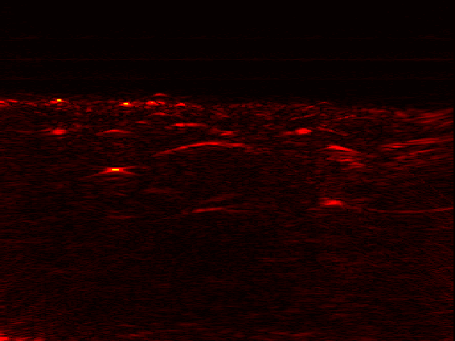
INTRODUCTION
Ultrasound and Photoacoustic Imaging
UL has better imaging depth
Area with optical scattering
Ultrasound (UL)
Photoacoustic (PA)
Contrast from impedance mismatch of reflected sound pulse waves off target surface / tissue
Pressure-sound waves generated by thermal expansion from optical laser energy absorption
DEPARTMENT OF ELECTRICAL AND COMPUTER ENGINEERING
GRAINGER ENGINEERING

Slide 4
Model Scheme
Convolutional Neural Network, NetP
Conditional Generative Adversarial Network, PowerNet
DEPARTMENT / UNIT NAME
GRAINGER ENGINEERING

Slide 5
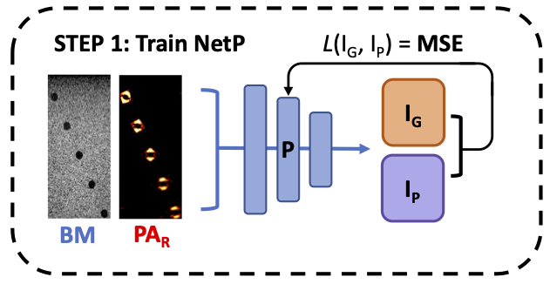
DEEP LEARNING MODEL DESCRIPTION
NetP
Purpose
Predict the laser intensity of the input photoacoustic image.
Convolutional Neural Network (cNN)
Retains spatial features, the arrangement of pixel in image
Retains the relation between pixels, features extracted over an area, not just local pixel information
MSE Loss Function
${{L(I}_{G}, I}_{P})= \frac{1}{n} \sum_{i=1}^{n}{{\left(I_{p}−I_{G}\right)}^{2}}$
DEPARTMENT OF ELECTRICAL AND COMPUTER ENGINEERING
GRAINGER ENGINEERING

Slide 6
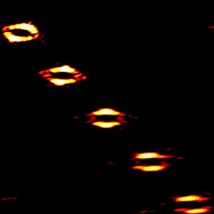
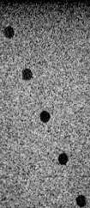
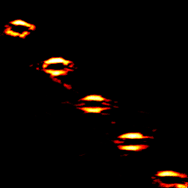
DEEP LEARNING MODEL DESCRIPTION
PowerNet – conditional Generative Adversarial Network (cGAN)
PA_{R}
Discriminator
1 = REAL
Real Image
D
0 = FAKE
I_{G}
UL
Generator
The Discriminator tries to identify real data from fakes created by the Generator
PA_{P}
Labels
U
cGAN Loss Function
Pixel-Based Loss Function L1 & SSIM
Intensity Loss Function
Fake Image
Random
Noise
The Generator extract features from labels and synthesize an imitation of real image to trick the Discriminator
DEPARTMENT OF ELECTRICAL AND COMPUTER ENGINEERING
GRAINGER ENGINEERING

Slide 7
Datasets & Results
Simulation Dataset (Lab Generated Controlled Data)
Array Phantom (Real, but Structurally Controlled Data)
Hand Blood Vessel (Real Complex Data)
DEPARTMENT / UNIT NAME
GRAINGER ENGINEERING

Slide 8
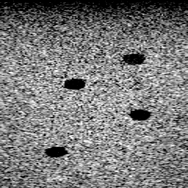
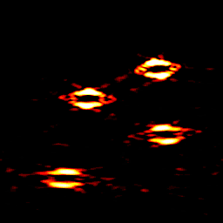
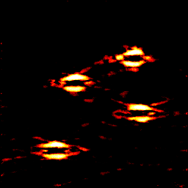
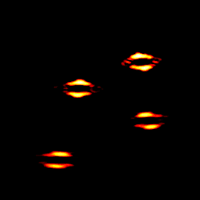
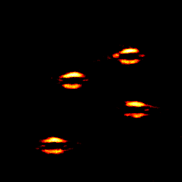
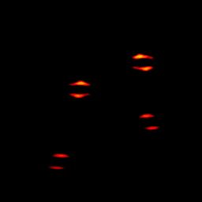
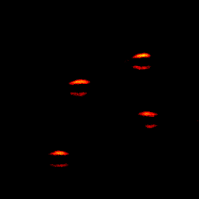
DATASET TRAINING & EVALUATION
Ultrasound BM
Attenuated PA
PowerNet PA
Simulation Dataset
Dataset with control over
Shape of structures
Location of structures
Number of structures
No background noise/artifacts
Trainings Purpose
Evaluate PowerNet’s ability to resynthesize attenuated PA in terms of shape, location, number of structures and corresponding laser intensity
10 mJ
5 mJ
2 mJ
DEPARTMENT OF ELECTRICAL AND COMPUTER ENGINEERING
GRAINGER ENGINEERING

Slide 9
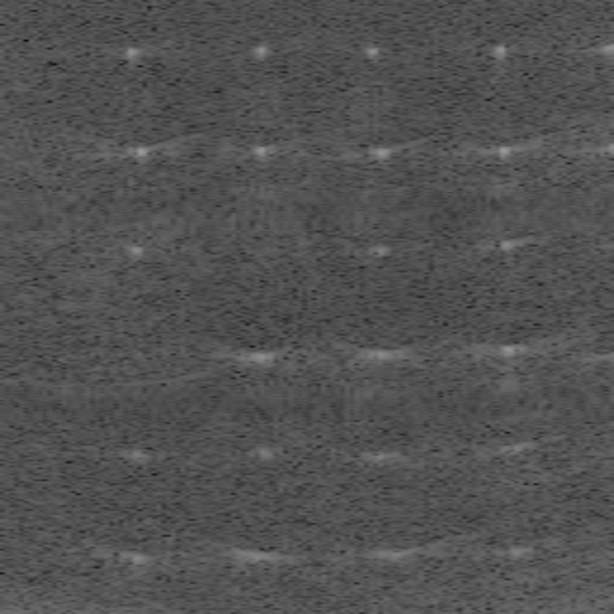
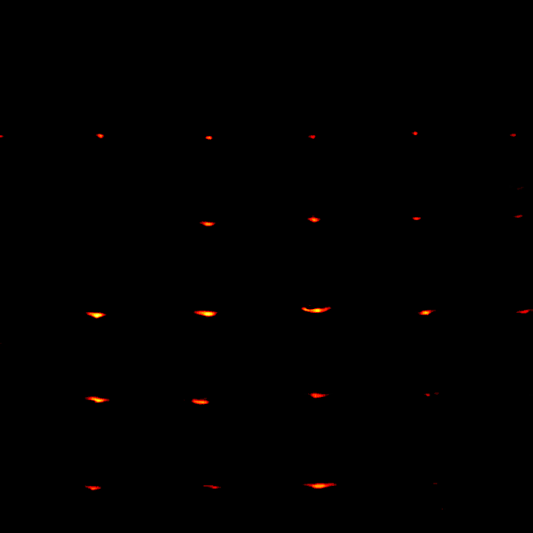
DATASET TRAINING & EVALUATION
Array Phantom Dataset
Trainings Purpose
Dataset has good point structures to demonstrate overcoming laser attenuation
Segmented each image into 9 patches
Trained with only patch 5 (greatest intensity)
Attenuation direction is radially outwards from center
Ultrasound BM
Attenuated PA
PowerNet PA
1
2
3
4
5
6
7
8
9
Gaussian Beam
Patch Segmentation
DEPARTMENT OF ELECTRICAL AND COMPUTER ENGINEERING
GRAINGER ENGINEERING

Slide 10
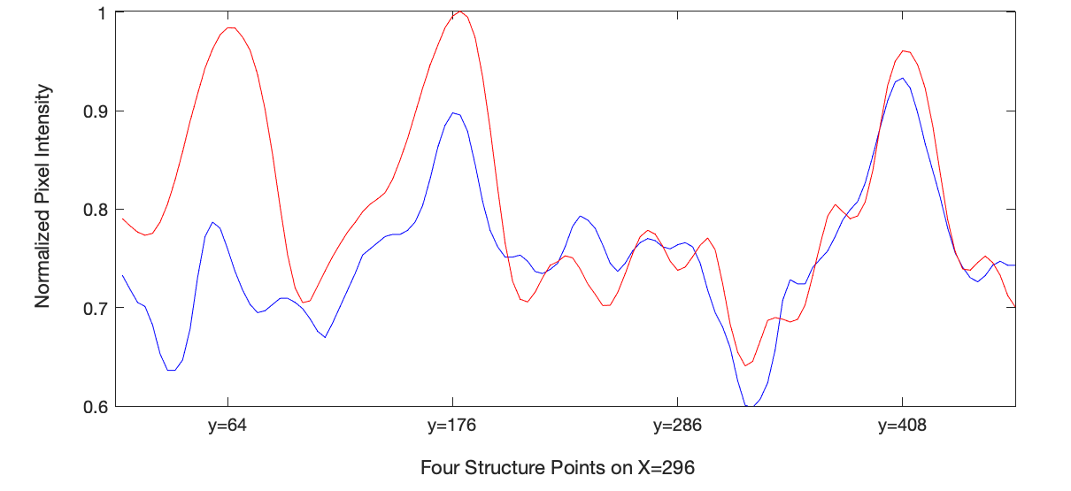
DATASET TRAINING & EVALUATION
Line Evaluation of Array Phantom
Ultrasound BM
Attenuated PA
PowerNet PA
Uniform Intensity
(No attenuation)
Attenuated Intensity
Attenuated PA
PowerNet PA
DEPARTMENT OF ELECTRICAL AND COMPUTER ENGINEERING
GRAINGER ENGINEERING

Slide 11
DATASET TRAINING & EVALUATION
Line Evaluation of Array Phantom
Ultrasound BM
Attenuated PA
PowerNet PA
Uniform Intensity
(No attenuation)
Reference Peak: similar in shape and magnitude
Attenuated Intensity
Attenuated PA
PowerNet PA
DEPARTMENT OF ELECTRICAL AND COMPUTER ENGINEERING
GRAINGER ENGINEERING

Slide 12
DATASET TRAINING & EVALUATION
Line Evaluation of Array Phantom
Ultrasound BM
Attenuated PA
PowerNet PA
Uniform Intensity
(No attenuation)
No Structure Peak: no structure to detect, no noticeable intensity peak
Attenuated Intensity
Attenuated PA
PowerNet PA
DEPARTMENT OF ELECTRICAL AND COMPUTER ENGINEERING
GRAINGER ENGINEERING

Slide 13
DATASET TRAINING & EVALUATION
Line Evaluation of Array Phantom
Ultrasound BM
Attenuated PA
PowerNet PA
Uniform Intensity
(No attenuation)
Attenuated Peak 1: PowerNet adjusted intensity magnitude to have uniform intensity
Attenuated Intensity
Attenuated PA
PowerNet PA
DEPARTMENT OF ELECTRICAL AND COMPUTER ENGINEERING
GRAINGER ENGINEERING

Slide 14
DATASET TRAINING & EVALUATION
Line Evaluation of Array Phantom
Ultrasound BM
Attenuated PA
PowerNet PA
Uniform Intensity
(No attenuation)
Attenuated Peak 2: Structure more attenuated, intensity magnitude still adjusted to achieve uniform intensity
Attenuated Intensity
Attenuated PA
PowerNet PA
DEPARTMENT OF ELECTRICAL AND COMPUTER ENGINEERING
GRAINGER ENGINEERING

Slide 15
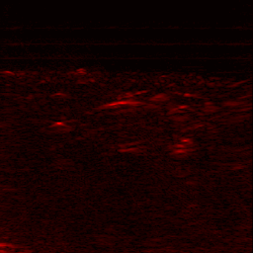
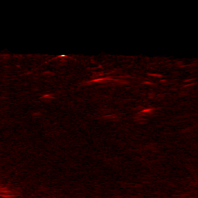
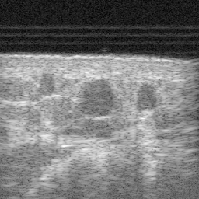
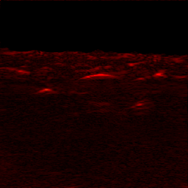
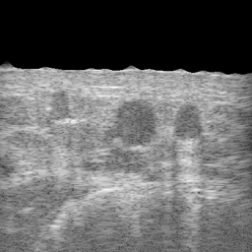
DATASET TRAINING & EVALUATION
Hand Blood Vessel Dataset
PowerNet PA
Attenuated PA
Ultrasound BM
Dataset with control over
Complex structures with varying information to extract
A lot of background noise/artifacts
Trainings Purpose
Evaluate PowerNet’s ability to learn and synthesize complex structures in real medical data
Original
Skin Segmented
DEPARTMENT OF ELECTRICAL AND COMPUTER ENGINEERING
GRAINGER ENGINEERING

Slide 16
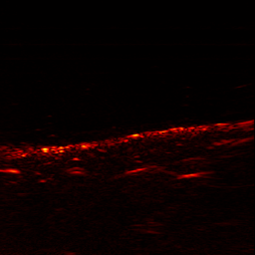
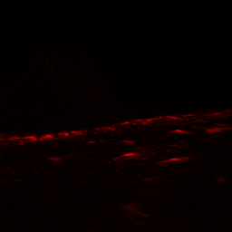
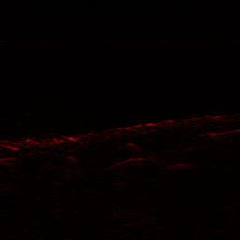
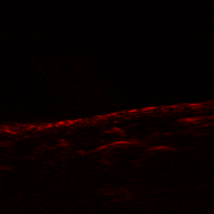
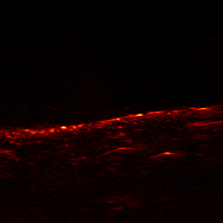
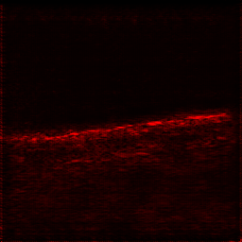
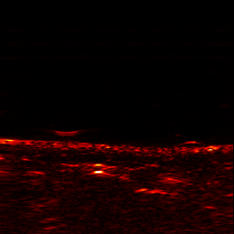
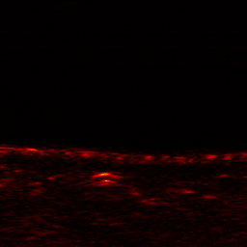
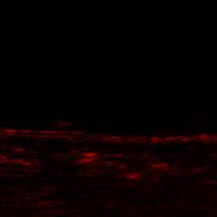
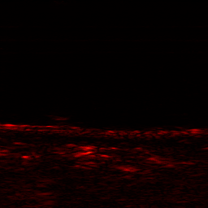
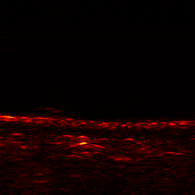
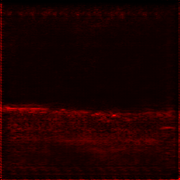
DATASET TRAINING & EVALUATION
Hand Blood Vessel Dataset
To see how incorporating intensity value can change PowerNet’s results.
Real PA
cGAN
powernet($λ_{p}$=5), 0.5 times
powernet($λ_{p}$=5)
powernet($λ_{p}$=5), 2 times
powernet($λ_{p}$=5), 10 times
CWSSIM: 0.5736
CWSSIM: 0.5096
CWSSIM: 0.6273
CWSSIM: 0.8569
CWSSIM: 0.7748
CWSSIM: 0.7900
CWSSIM: 0.5204
CWSSIM: 0.7361
CWSSIM: 0.8981
CWSSIM: 0.6533
DEPARTMENT OF ELECTRICAL AND COMPUTER ENGINEERING
GRAINGER ENGINEERING

Slide 17
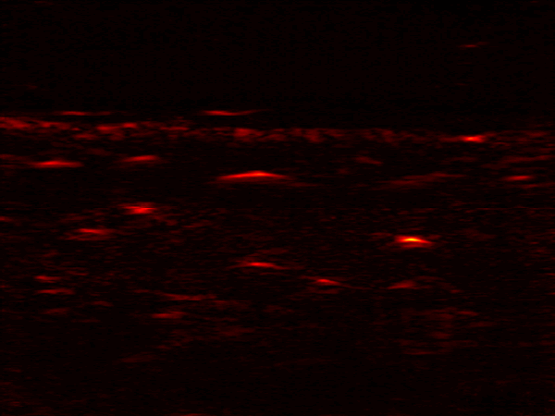
DATASET TRAINING & EVALUATION
Hand Blood Vessel Dataset
150~0
100~250
Layer training, technique similar to Array Phantom Patch training, can successfully recover the intensity of structures deeper in tissues
200~350
300~450
Ultrasound BM
Attenuated PA
PowerNet PA
DEPARTMENT OF ELECTRICAL AND COMPUTER ENGINEERING
GRAINGER ENGINEERING

Slide 18
CONCLUSION
Resolved
Simulation dataset : synthesize correct structure shape, location, and number of structures
Array Phantom dataset : synthesize non-attenuated PA with uniform intensity
Hand Blood Vessel dataset :
capture complex structures in real medical data
synthesize non-attenuated PA with uniform intensity
Limitations and Future Improvements
Working on methods to evaluate and confirm that the PowerNet PA results are clinically correct
Continue searching for image similarity evaluation method
Special thanks to Kevin Huang, Professor Chen Yun-Sheng, Professor Zhao Yang, and the Y2Lab.
DEPARTMENT OF ELECTRICAL AND COMPUTER ENGINEERING
GRAINGER ENGINEERING

